Slide 1

Ethical Student Hackers
BakeryTF

Slide 2
The Legal Bit
The skills taught in these sessions allow identification and exploitation of security vulnerabilities in systems. We strive to give you a place to practice legally, and can point you to other places to practice. These skills should not be used on systems where you do not have explicit permission from the owner of the system. It is VERY easy to end up in breach of relevant laws, and we can accept no responsibility for anything you do with the skills learnt here.
If we have reason to believe that you are utilising these skills against systems where you are not authorised you will be banned from our events, and if necessary the relevant authorities will be alerted.
Remember, if you have any doubts as to if something is legal or authorised, just don't do it until you are able to confirm you are allowed to.

Slide 3
Code of Conduct
Before proceeding past this point you must read and agree to our Code of Conduct - this is a requirement from the University for us to operate as a society.
If you have any doubts or need anything clarified, please ask a member of the committee.
Breaching the Code of Conduct = immediate ejection and further consequences.
Code of Conduct can be found at https://shefesh.com/downloads/SESH%20Code%20of%20Conduct.pdf

Slide 4
What is a CTF?
A series of hacking challenges
We have challenges aimed at beginners all the way up to experienced CTF players
We also have some programming/scripting focused challenges, so you don’t need to know everything about cyber
The challenge will tell you what URL to visit, or give you any files you need
Flags are in the format sesh{This_Is_The_Flag}
Several categories, including:
Web Hacking
Cryptography
Steganography
We will be releasing some more challenges as the weekend goes on to keep you on your toes, so don’t worry if you run out of things to solve!

Slide 5
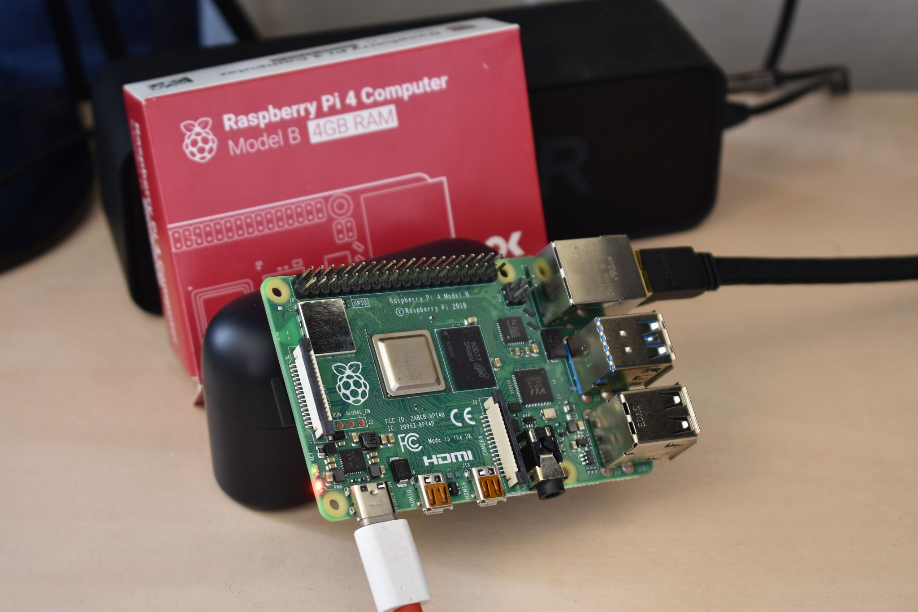
What’s Different about Ours?
The main prize!
We have a Raspberry Pi 4 Model B 4GB up for grabs!
How do you win it?
You just have to own it!
Get root access on the Pi and submit the flag to win!
Where to start? The first step is finding the IP
See the ‘Raspberry Peist’ challenge category

Slide 6
Other Prizes
SESH Hoodie (worth ~£25)
HTB Vouchers (£60, £30, £15)
Try Hack Me Vouchers (1 month free!
How does the prize system work?
If you root the Pi, you take it home
Then person with first, second and third most points get first, second and third choice of any prize from the pool
If no one roots the pi, the person who got closest will also get a pick from the prize pool - so make sure you submit flags along the way!
Each person can only have one prize

Slide 7
Quick Rules
Some housekeeping:
Besides the Raspberry Pi itself, you shouldn’t be attacking our infrastructure!
The challenges might be vague in scope, but you should never have to attack or gain code execution on the underlying machine
If in doubt, stop!
Don’t be overzealous with your scans
You shouldn’t have to brute force any of our challenges (apart from maybe some password cracking…)
We are hosting our challenges on low-powered infrastructure, so please don’t fire off too many massive scans - if you can’t figure out the next step, take a step back and try harder ;)
Don’t break AWS Pen Testing Policy
We are hosting our infrastructure in the Cloud, so don’t break AWS’ rules
View them here: https://aws.amazon.com/security/penetration-testing/
Don’t attack other players! No stealing cookies with XSS, phishing each other etc - be nice
And general CTF etiquette - no deleting flags! And if you think you’ve crashed a challenge, just let us know in discord
If you have any doubt, just ask us in Discord

Slide 8
What Next?
Get hacking!
If you haven’t already, sign up for an account at ctf.shefesh.com
Join our Discord server!
Committee will be available throughout most of the weekend to answer questions
https://discord.gg/fKv7a9tW
Come to our prizegiving ceremony on Monday, 18:00 BST
We will also go over some challenge solutions if we have time
Happy Hacking :)

Slide 9

Any Questions?
www.shefesh.com
Thanks for coming!

